Slide 1
An Introduction to Generalized Linear Models
Prof Patrick Musonda
Email: (pmuzho@hotmail.com)
Lead Medical Statistician
University of Zambia
Tel: 0963 256 318
With thanks to Lee Shepstone for some of these slides

Slide 2
Outline
Background
Some principles of statistical modelling
Distribution related to the Normal distribution
Exponential family and Generalized Linear Models
Normal linear models
Binary Variables and Logistic Regression
Nominal and Ordinal Logistic Regression
Count data, Poisson Regression and Log-linear Models

Slide 3
Background
Familiarity of the following statistical principles and methods are assumed in particular:
Concepts of estimation, sampling distributions and hypothesis testing.
Use of t-tests, analysis of variance, simple linear regression and chi-squared tests of independence for two-dimensional contingency tables is assumed.
To apply the ideas taught in this course, access to statistical software is mandatory, in particular, stata.

Slide 4
Background
The statistical methods considered all involve the analysis of relationships between measurements made on groups of subjects or objects.
E.g. measurements might be heights, or weights and the ages of boys and girls.
We will use the terms response, outcome or dependent variable for measurements that are free to vary in response to other variables
Called the explanatory variables or predictor variables or Independent variables
Responses are regarded as random variables.
Explanatory variables are usually treated as though they are non-random measurements or observations; e.g. they may be fixed by experimental design.

Slide 5
Background
Responses and explanatory variables are measured on one of the following scales:
1. Nominal classifications: e.g. red, green, blue; yes, no, do not know, not applicable (categorical, no obvious order).
In particular, for binary, dichotomous or binomial variables there only two categories: male, female; dead, alive;
If there are more than two categories the variable is called polychotomous, or polytomous or multinomial.
2. Ordinal classifications in which there is some natural order or ranking between the categories: e.g. young, middle aged, old;

Slide 6
Background
Diastolic blood pressures grouped as: <=70, 71-90, 91-110, 111-130, >=131 mm Hg.
3. Continuous measurements where observations may, at least in theory, fall anywhere on a continuum: e.g. weight, height, BMI, length or time.
This scale includes both interval scale and ratio scale measurements
Nominal and ordinal data are sometimes called categorical or discrete variables and the numbers of observations, counts or frequencies in each category are usually recorded.
The term quantitative is often used for a variable measured on a continuous scale and the term qualitative for nominal and sometimes for ordinal measurements.

Slide 7
Background
A qualitative, explanatory variable is called a factor and its categories are called the levels for the factor.
A quantitative explanatory variable is sometimes called a covariate.
Methods of statistical analysis mainly depend on the measurement scales of the response/outcome/dependent and also on explanatory variables.
This course is mainly concerned with those statistical methods which are relevant when there is just one response variable, although there usually several explanatory variables.
The responses measured on different subjects are usually assumed to be statistically independent random variables

Slide 8
Statistical Modelling process
The statistical modelling process involves four steps:
First what is a statistical Model? A statistical model is a representation of the population under study using statistical methodology.
The model usually reflects the way in which data have been sampled from the population.
Specify models in two parts: an equation linking the response/outcome/dependent and explanatory variables, and the probability distribution of the response variable.
Estimating parameters used in the models. Parameters in the model correspond to features of the population. In practice the true values of the parameters are unknown and so the sample is used to draw inferences about them.
Checking how well the models fit the actual data.

Slide 9
Statistical Modelling process
4. Making inferences; for examples, calculating confidence intervals and testing hypotheses about the parameters.
In modelling we also think about ideas of Parameter Estimators. These are sample statistics that are used to provide estimates of the unknown parameters.
Estimator refers to the general form of the statistic (a random variable), while an estimate refers to the actual numerical realisation from a given sample.
Hypotheses: These are statements about the unknown parameters, e.g. a parameter takes a particular value e.g. Or two parameters are equal

Slide 10
Distributions related to the Normal distribution.
The sampling distributions of many of the estimators and test statistics used in this course depend on the Normal distribution.
They do so either directly because they are derived from Normally distributed random variables, or asymptotically, via the Central Limit Theorem for large samples.
If the random variable Y has the Normal distribution with mean and variance its probability density function is
We denote this by

Slide 11
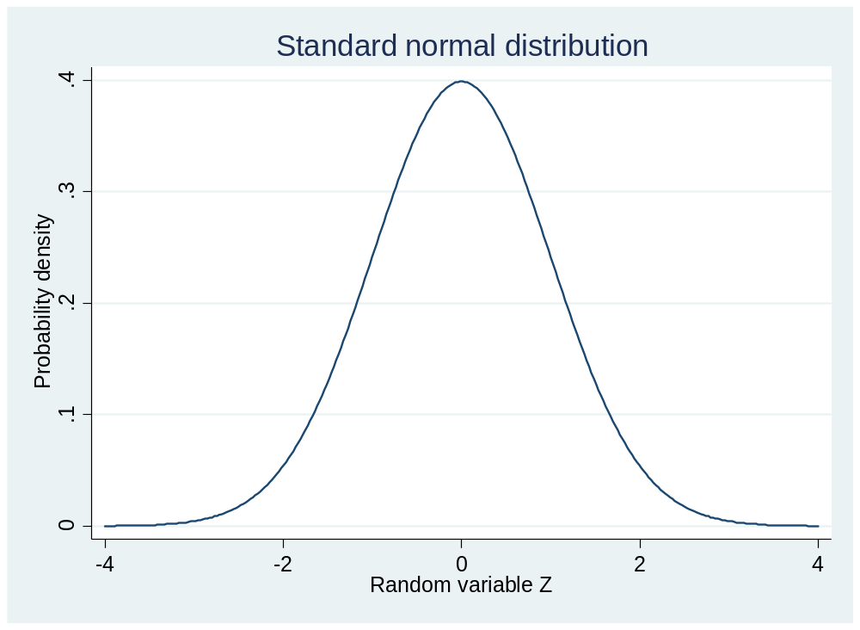
Distributions related to the Normal distribution.
The normal distribution with and , is called the standard Normal distribution.
Figure 1.
There are a number of other variants of distributions that end up following a normal distributions.

Slide 12
Exponential Family and Generalised Linear Models
Many of the nice properties of the Normal distributions are shared by a wider class of distributions called the exponential family of distributions.
The density of random variable can be written
And the logarithm of this is (Activity. 1, show that)

Slide 13
Exponential Family and Generalised Linear Models
With some reparametrisation and rearranging this takes on a very special form:
Distributions that can be written in the form of [1] are said to belong to the exponential family of distributions.
Such distributions on the log-scale, follow a normal distribution under the central limit theorem.
Activity 2, show that [1] is the same as logarithm of f(y) given on the previous slide

Slide 14
Exponential Family and Generalised Linear Models
TWO IMPORTANT EXAMPLES
The Poisson Distribution
Taking natural logarithms of the above, we get:
Activity.3, show all the steps to arrive at this expression.

Slide 15
The exponential family of distributions
TWO IMPORTANT EXAMPLES
2. The Binomial distribution
Note: is called the canonical or natural parameter the scale parameter.
Activity 4, show all the steps to arrive at this expression

Slide 16





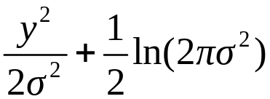
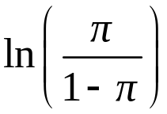
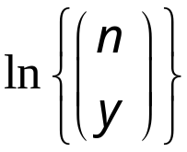

Poisson, Normal and binomial distributions as members of the exponential family
The form:
Distribution | Natural parameter
Poisson
Normal
Binomial

Slide 17
A COUNTER EXAMPLE THE CAUCHY DISTRIBUTION
The Cauchy distribution is a heavy-tailed distribution for continuous observations, with given by the formula:
Taking logs with the above distribution, we get:
This cannot be expressed in the form [1], so this is not a member of exponential family.
So there other distributions which can be expressed in the form of [1] others cannot, only those that can, are considered member of exponential family of distributions
Activity 5, show all the steps to arrive at this expression.

Slide 18
Definition of a Generalized linear Model (GLM)
A GLM has three components
1. Response Distribution: The response variables are assumed to be independent, arising from an exponential family distribution, with .
2. Linear Predictor: The explanatory variables enter the model in a linear combination with unknown parameters: for the subject we have the linear predictor:
3. Link Function: The link function relates the linear predictor to the mean

Slide 19
GLM
Example: Simple Linear Regression, , Response Distribution: This is normal.
Linear Predictor: There is only a single explanatory variable
Link Function: The link function is the identity function:

Slide 20
Important notes on GLM
The linear predictor is linear in the parameters, not necessarily in the explanatory variables. For example, in polynomial regression, powers of the variables occur:
On the other hand: is not a linear predictor.
Fitting a model to the data means obtaining the maximum likelihood estimates (MLE’s) of the parameters
The ‘log likelihood of the model’ is usually shorthand for ‘the log likelihood function of the model for the given data evaluated at the MLE’s of the parameters, i.e. the maximum of the log likelihood function

Slide 21
Important notes on GLM
5. With minor exceptions, the underlying theory (parameter estimation, inference, model assessment and comparison) proceeds in the same way for all GLM’s; it is just the distribution and link that differ
6. The link function is chosen to provide a suitable scale for the effects of explanatory variables to operate in a linear manner. Typically the range of will be transformed to the whole real line
7. From now on, the terms ‘model’, ‘generalized linear model’ and ‘GLM’ will be used interchangeably.

Slide 22
Important notes on GLM
8. Important GLM’s in this course are:
Linear regression (continuous outcome), Distribution normal, link function identity
Logistic regression (binary outcome), Distribution binomial, link function/s: There are three common choices (others exist, some quite complex)
Each maps the probability on the range (0,1) to the linear predictor on the range , logit, probit, complementary log-log
Poisson regression (rates and counts outcome), Distribution Poisson, link function log

Slide 23
Fitting GLM using stata
The GLM command in stata can be used to fit any generalized linear model. The basic form of the command is:
glm <response variable><explanatory variable/s to form linear predictor>, family(<name of distribution>) link(<link function>)
The above are the available link functions, but will only apply a few
Link function | glm option
identity | link(identity)
log | link(log)
logit | link(logit)
probit | link(probit)
complementary log-log | link(cloglog)
odds power | link(opower #)
power | link(power #)
negative binomial | link(nbinomial)
log-log | link(loglog)
log-complement | link(logc)

Slide 24
Fitting GLM using stata
The available distributional families are:
In stata, one does not need to specify both family() and link(); the default link is the canonical link for specified family() (except for nbinomial.
Family | glm option
Gaussian (normal) | family(gaussian)
Inverse Gaussian | family(igaussian)
Bernoulli/Binomial | family(binomial)
Poisson | family(poisson)
Negative Binomial | family(nbinomial)
Gamma | family(gamma)

Slide 25
Fitting GLM using stata
The following table shows the default link family.
If you specify both family and link, not all combinations make sense. You may choose from the following combinations:
Family | Default link
family(gaussian) | link(identity)
family(igaussian) | link(power -2)
Family(binomial) | link(logit)
family(poisson) | link(log)
family(nbinomial) | link(log)
family(gamma) | link(power -1)

Slide 26
Fitting GLM using stata
 | Link function
Family | id | log | logit | probit | clog | power | opower | nbinomial | loglog | logc
Gaussian | x | x |  |  |  | x
Inv. Gaussian | x | x |  |  |  | X
Binomial | x | x | x | x | x | x | x |  | x | x
Poisson | x | x |  |  |  | x
Negative binomial | x | x |  |  |  | x |  | x
gamma | x | x |  |  |  | x
In stata, there is usually more than one way to fit GLM model, we will try and show alternative methods.
It does not matter which method you use, as long as you are getting the same answer
And be able to interpret your findings properly

Slide 27
Fitting GLM using stata
The data shown in the table below will be used for the first example.
pi | carbohydrate | age | weight | protein
1 | 33 | 33 | 100 | 14
2 | 40 | 47 | 92 | 15
3 | 37 | 49 | 135 | 18
4 | 27 | 35 | 144 | 12
5 | 30 | 46 | 140 | 15
6 | 43 | 52 | 101 | 15
7 | 34 | 62 | 95 | 14
8 | 48 | 23 | 101 | 17
9 | 30 | 32 | 98 | 15
10 | 38 | 42 | 105 | 14
11 | 50 | 31 | 108 | 17
12 | 51 | 61 | 85 | 19
13 | 30 | 63 | 130 | 19
14 | 36 | 40 | 127 | 20
15 | 41 | 50 | 109 | 15
16 | 42 | 64 | 107 | 16
17 | 46 | 56 | 117 | 18
18 | 24 | 61 | 100 | 13
19 | 35 | 48 | 118 | 18
20 | 37 | 28 | 102 | 14

Slide 28
Fitting GLM using stata
The data comes from study of 20 insulin-dependent diabetics in which the response/(outcome) was percentages of total calories obtained from complex carbohydrates
The patients in the study were on a high-carbohydrate diet for six months.
In this study, compliance with the regime was thought to be related to age (in years),
Body weight (relative to ‘ideal’ weight for height),
And other components of the diet, such as the percentage of calories as protein

Slide 29
Fitting GLM using stata
So, the question of interest in this study was:
Is the percentage of total calories obtained from complex carbohydrates related to age (years), body weight (relative to ideal weight for height) and percentages of calories obtained from protein?
In other words, the response/outcome variable is percentage of total calories obtained from complex carbohydrates
The explanatory/predictor variables are: age (years), body weight relative to ideal weight for height, and protein (i.e. percentage of calories from protein)

Slide 30
Fitting GLM using stata
Note that all variables in this data are continuous variables
In other words, we want to fit the model:
In other words, we are fitting the model:
So to do this in stata, we are going to enter the data into stata from first principles, please let us open the dofile:
glm activities on a linear model.do

Slide 31
Fitting GLM using stata
The full command to fit a GLM model is:
glm carbohydrate age weight protein, family(gaussian) link(identity)
Alternatively, we can use the command without declaring link:
glm carbohydrate age weight protein, family(gaussian)
Or we can use the command without declaring the family option:
glm carbohydrate age weight protein, link(identity)
The default values in the glm command is family Gaussian and link identity see command below.

Slide 32
Fitting GLM using stata
glm carbohydrate age weight protein
We can easily use the regression command to fit the data as shown below:
regress carbohydrate age weight protein
Note largely, we get similar values albeit the output table is slightly different.
The p-values are different because of different tests used and the convergence processes to obtain the maximum likelihood estimates are different

Slide 33
Fitting GLM using stata
The GLM command uses z-test to tests the significance of the regression coefficients
Whereas, the regression command uses the t-test to test the significance of the regression coefficients
Hence, you will also note that the CIs are also different for the estimates from GLM command to those of the regression command.
The convergence procedure, the glm command uses:
Iterated reweighted least-squares optimisation process
Whereas, the regression command uses: only least squares optimisation process

Slide 34
Fitting GLM using stata: interpretation of the carbohydrates data
We will present results from the GLM command, but either results should lead to more or less same interpretation.
The associated equation (model) in the above table is:
We don’t normally worry about interpreting the constant, but if we are to interpret the constant in the above, this suggests.
Term | Estimate | p-value | 95% CI
Constant | 36.960 | 0.005 | (11.341, 62.579)
Age | -0.114 | 0.298 | (-0.328, 0.101)
Weight | -0.228 | 0.006 | (-0.391, -0.065)
Protein | 1.958 | 0.002 | (0.713, 3.202)

Slide 35
Fitting GLM using stata: interpretation of the carbohydrates data
Without taking account of age, body weight relative to ideal weight for height and percentage of calories from protein
The average change in total calories obtained from complex carbohydrates is 36.960 %, 95% CI (11.341, 62.579), this is statistically significant (p-value=0.005).
The coefficients of age means: For each year increase in age, percentages of total calories obtained from complex carbohydrates are reduced by about 0.114% taking account of body weight relative to ideal weight for height and percentage of calories from protein. The reduction is not statistically significant, p-value=0.298
Estimates for weight means: one unit increase in body weight relative to ideal weight for height decreases the percentage of total calories obtained from complex carbohydrates by about 0.228%

Slide 36
Fitting GLM using stata: interpretation of the carbohydrates data
while controlling for age and percentage of calories from protein. This is a real decrease in that we can rule out chance finding given that the estimate is statistically significant.
The estimated decrease can be as low as 0.065% to as high as 0.398% with probability 0.95 from the population where this sample comes from (this is another way of interpreting 95% CI).
The possible interpretation protein is:
The effect of one percent of calories from protein is to increase the total calories from complex carbohydrates by 1.958% which could be an increase as low as 0. 713% to as high as 3.202% adjusting for age and body weight relative to ideal weight for height.

Slide 37
Fitting GLM using stata:
Should we include all explanatory variables in the model?
One question that may arise, should we include all variables in the model?
In statistics we do have the principle of parsimony.
The Oxford Dictionary describes the law of parsimony (otherwise known as Occam’s Razor) as the principle that no more causes should be assumed than will account for the effect.
This simply means a simpler or more parsimonious model that describes the data adequately is preferable to a more complicated one which leaves little of the variability unexplained.

Slide 38
Fitting GLM using stata:
Should we include all explanatory variables in the model?
In other words, a model with fewer variables and explains the data well is better than a model with a lot of variables.
To determine a parsimonious model consistent with the data, we test the hypotheses about the parameters.
Hypothesis testing is performed in the context of model fitting by defining a series of nested models corresponding to different hypotheses.
Then the question about whether the data support a particular hypothesis can be formulated in terms of the adequacy of fit of the corresponding model relative to other more complicated models.

Slide 39
Fitting GLM using stata:
Should we include all explanatory variables in the model?
We note from the p-values from the carbohydrates data that the effect of age was not significant.
One question that may arise would be: should we include age in the model or a model without age better?
There are number of approaches to make such a decision. One approach would be to decide given that the effect of age is not significant, we may choose to drop age from the model and refit the model without age.
The other approach would be just to fit nested models and test the these models using likelihood ratio test (see details about likelihood ratio test from any of the books in the references given)

Slide 40
Fitting GLM using stata:
Should we include all explanatory variables in the model?
A nested model is a model containing all other explanatory variables from the full model as shown below:
In the above, we can see a model with and without age. A model without age is a nested model from the full model.
So we can test the null hypothesis that the regression coefficient of ‘age’ is equal to zero using the likelihood ratio test of:

Slide 41
Fitting GLM using stata:
Should we include all explanatory variables in the model?
So in statistical sense, we want to test:
This suggests that if we reject the null hypothesis (p-value<=0.05), then full model is a better model, we should include age in the model, in other words, regression coefficient of age not equal to zero.
Otherwise, if we fail to reject the null hypothesis (p-value>0.05), then the nested model is better, the regression coefficient could be zero, therefore a better model is a model without age.
Now let us test the hypothesis using stata.

Slide 42
Fitting GLM using stata:
Should we include all explanatory variables in the model?
We shall use estimates from the glm command, and in stata we fit the full model first, store estimates, and then fit the nested model
glm carbohydrate age weight protein, family(gaussian) link(identity)
estimates store fmodel
glm carbohydrate weight protein, family(gaussian) link(identity)
estimates store nmodel
To test the hypothesis using likelihood ratio tests, we have a number of ways of doing this and these are shown below
lrtest fmodel .
lrtest fmodel //(equivalent to above command)
lrtest fmodel nmodel //(equivalent to above command)

Slide 43
Fitting GLM using stata:
Should we include all explanatory variables in the model?
We can see from each of the output from the commands that we are getting same results.
The conclusion from the likelihood tests of the two models is:
Given that the p-value=0.253, then we fail to reject the null hypothesis, hence the regression coefficient of age could be zero
And as such, the nested model is better, therefore the model without age in this instance is better.
So age is not making any contribution in the model.

Slide 44
Fitting GLM using stata:
The best model.
The two models are shown below.
Full model
Nested model.
Term | Estimate | p-value | 95% CI
Constant | 36.960 | 0.005 | (11.341, 62.579)
Age | -0.114 | 0.298 | (-0.328, 0.101)
Weight | -0.228 | 0.006 | (-0.391, -0.065)
Protein | 1.958 | 0.002 | (0.713, 3.202)
Term | Estimate | p-value | 95% CI
Constant | 33.130 | 0.008 | (8.491, 57.770)
Weight | -0.222 | 0.008 | (-0.385, -0.058)
Protein | 1.824 | 0.003 | (0.603, 3.046)

Slide 45
Fitting GLM using stata:
The best model: Interaction effect
The best model has two continuous explanatory variables, i.e. weight and protein
One question that may arise is that: is there an interaction effect between body weight relative to ideal weight and percentage of calories as protein?
The above question simply means that is the effect of weight for particular value of protein different on the percentages of calories obtained from complex carbohydrates?
Interaction effects of continuous variables on continuous variables are relatively complex to show.

Slide 46
Fitting GLM using stata:
The best model: Interaction effect
This is because we have a lot of combinations between values. Usually the estimate is presented
But we can show interaction effect between two continuous variables by using contour graphs
First we need to fit the model giving the interaction effect
The command in stata is given as follows:
glm carbohydrate c.weight##c.protein, family(gaussian) link(identity)
The results are shown below:

Slide 47
Fitting GLM using stata:
The best model: Interaction effect
The results shows the main effects and the interaction effects:
glm carbohydrate c.weight##c.protein, family(gaussian) link(identity)
Iteration 0: log likelihood = -59.868157
AIC = 6.386816
Log likelihood = -59.86815696 BIC = 418.2945
------------------------------------------------------------------------------------
| OIM
carbohydrate | Coef. Std. Err. z P>|z| [95% Conf. Interval]
-------------------+----------------------------------------------------------------
weight | .7915501 .4686643 1.69 0.091 -.1270151 1.710115
protein | 9.485715 3.542947 2.68 0.007 2.541666 16.42976
|
c.weight#c.protein | -.0650883 .0297163 -2.19 0.029 -.1233312 -.0068455
|
_cons | -85.94705 55.54058 -1.55 0.122 -194.8046 22.91048
------------------------------------------------------------------------------------
We see the interaction estimates as: -0.065, 95%CI, (-0.123, -0.007), p-value=0.029.

Slide 48
Fitting GLM using stata:
The best model: Interaction effect
This interaction effect suggests that:
For the average value of body weight relative to the ideal weight for height and the average value of percentage of calories as protein,
Their effect is to reduce percentages of total calories obtained from complex carbohydrates by about 0.065%, and this reduction could be as low as 0.007% to as high as 0.123% with probability 0.95.
The above effect takes account of the individual effect of body weight relative to the ideal weight for height and the individual effect of percentage of calories as protein.

Slide 49
Fitting GLM using stata:
The best model: Interaction effect
As mentioned before, the contour plots will better represent the interaction effect.
To plot the interaction effect of weight and protein using contour plots, please follow the steps in the do file from the section entitled:
//FITTING AN INTERACTION OF CONTINUOUS VARIABLE VS A CONTINUOUS VARIABLE
The resulting plot after following the steps is the graphs shown below.

Slide 50
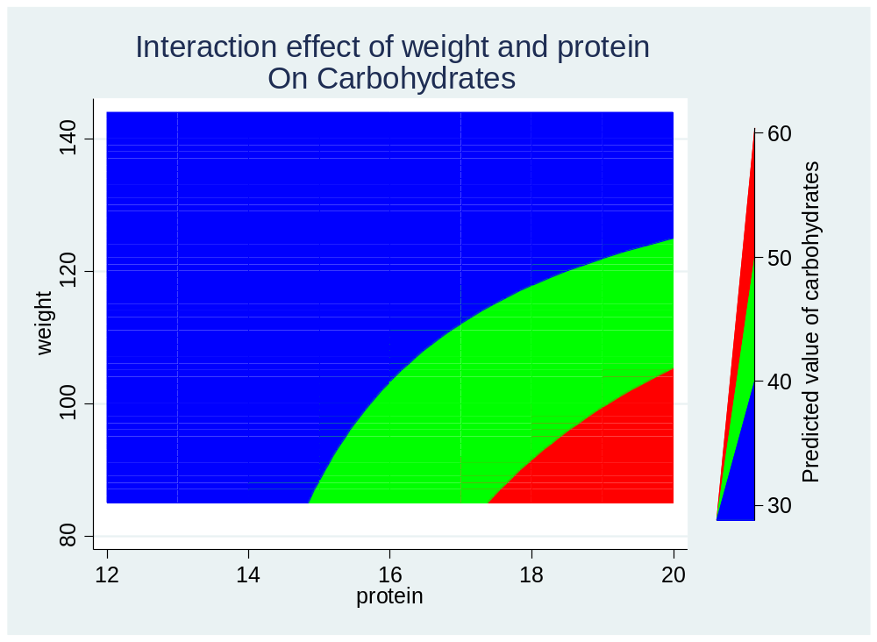
Fitting GLM using stata:
The best model: Interaction effect
The plot the interaction effect
These are differences in the effect both weight and protein has on carbohydrates
The vertical legend shows the predicted values of carbohydrates for particular combination of weight and protein
Figure 2.
For percentage of calories obtained from protein in the range 12-15%, and

Slide 51
Fitting GLM using stata:
The best model: Interaction effect
Weight relative to ideal weight for height in the range approx. 84 to 144 predicts percentages of total calories obtained from carbohydrates in the range 30-40%
For the combination of percentage calories obtained from protein in the range 15 to 17% and weight relative to ideal weight for height in the range approx. 84 to 120 predicts percentages of total calories obtained from carbohydrates in the range 40-50%.
And for the combination of percentage calories obtained from protein in the range 17 to 20% and weight relative to ideal weight for height in the range approx. 84 to 102 predicts percentage of total calories obtained from carbohydrates in the range 50-60%
The contour plot gives automatic predicted cut off, but we can change this as shown in the next command and plot below.

Slide 52
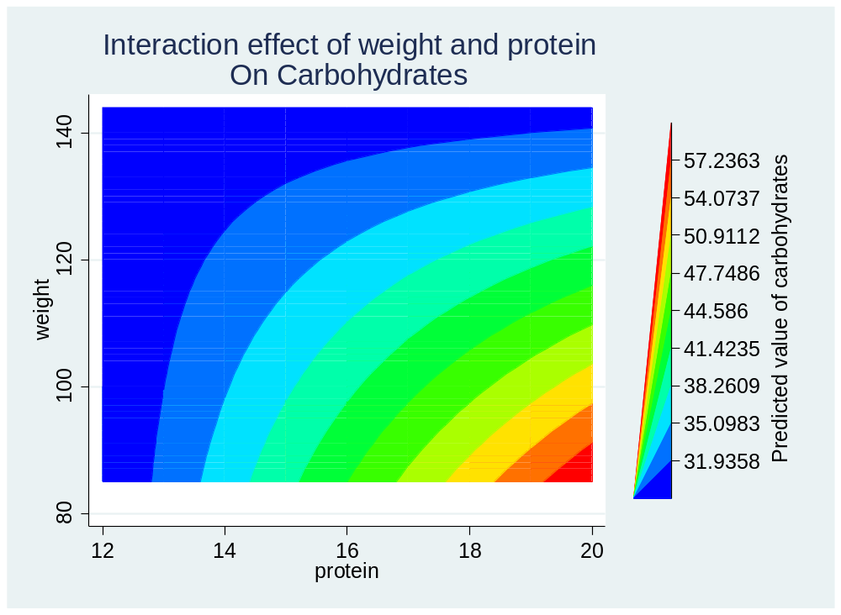
Fitting GLM using stata:
The best model: Interaction effect
twoway (contour bwtpred weight protein, levels(10)), ///
title("Interaction effect of weight and protein" "On Carbohydrates")
We note finely tuned differences or interaction effect
Figure 3

Slide 53
Fitting GLM using stata: example 2
The data in the Table below shows birth weights (in grams) and estimated gestational ages (in weeks) of 12 male and female babies born in a certain hospital.
Boys |  | Girls
Age | Birth weight | Age | Birth weight
40 38 40 35 36 37 41 40 37 38 40 38 | 2968 2795 3163 2925 2625 2847 3292 3473 2628 3176 3421 2975 | 40 36 40 38 42 39 40 37 36 38 39 40 | 3317 2729 2935 2754 3210 2817 3126 2539 2412 2991 2875 3231

Slide 54
Fitting GLM using stata: example 2
The question of interest is whether there is a relationship between birth weight and gestation age and whether this relationship is different between boys and girls.
We shall enter the data in stata as shown in the do file.
Now note that the equation we would like to fit is in the form:
Now fitting this using a glm command, we have:

Slide 55
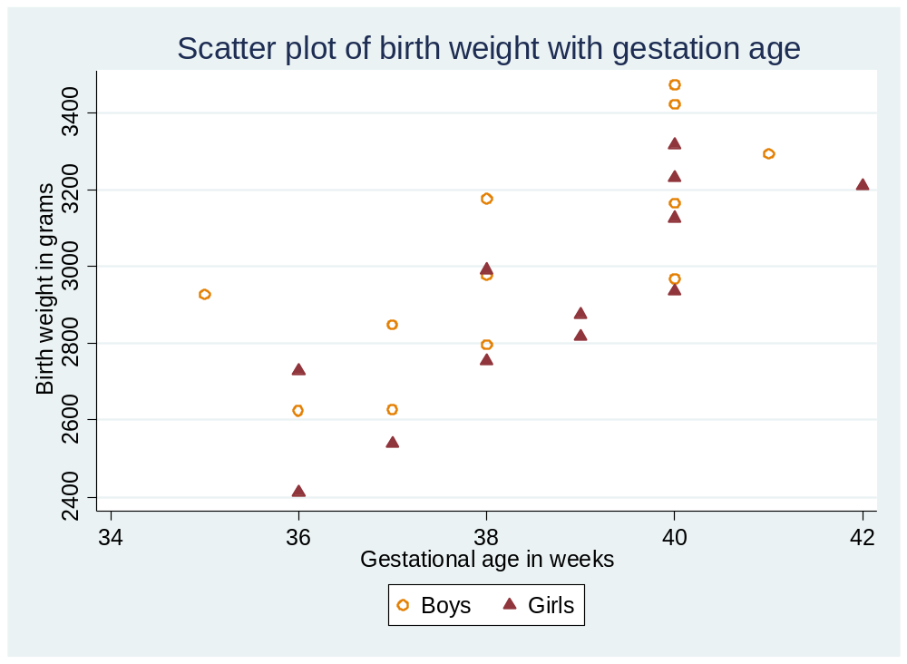
Fitting GLM using stata: example 2
To explore relationships, we may begin by plotting a scatter plot of birth weight with gestation weight for boys and girls as shown in Figure 4 below
Figure 4.

Slide 56
Fitting GLM using stata: example 2
Figure 2 shows that there is an indication that there is a linear trend/(relationship) of birth weight increasing with gestation age
It also appears like girls tend to weigh less than the boys of the same gestational age.
One interesting thing would be to plot a scatter plot for boys and girls and also fit the fitted line for both boys and girls
We can do this in stata using the command given in the do file.
Running the command, we get Figure 5.

Slide 57
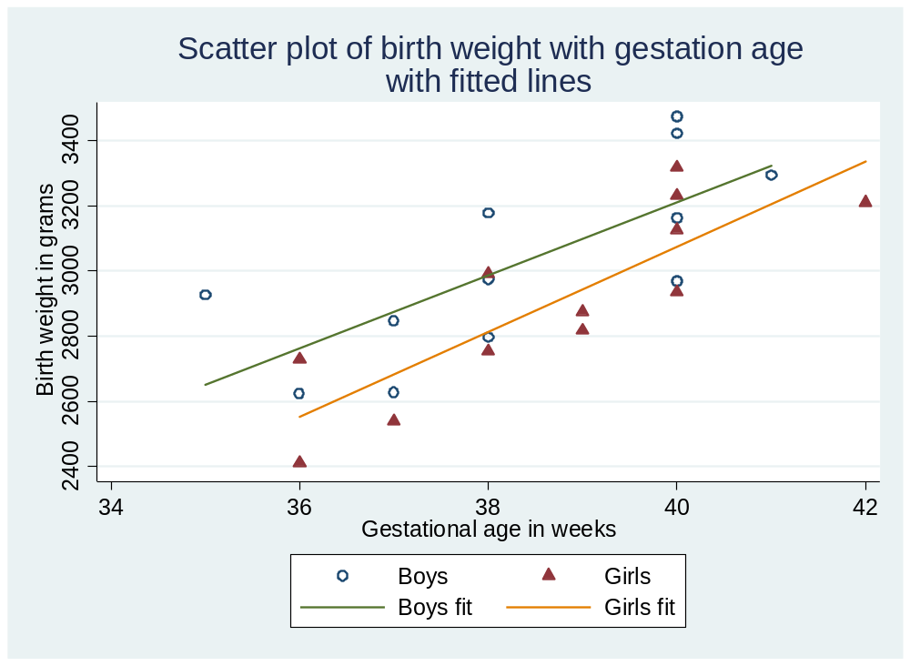
Fitting GLM using stata: example 2
We can see the differences and the boys fitted line seems to be above the girls fitted line, again showing that boys birth weight was larger on average.
Figure 5.

Slide 58
Fitting GLM using stata: example 2
Overall, the lines shows that there is a positive relationship of birth weight with gestation age taking account of sex.
This positive relationship is different for boys and girls,
This difference is manifested in the fact that the average birth weight was consistently higher for boys than that of girls.
We can now quantify this relationship in terms of regression and test the significance of the relationship
We can fit the linear regression and shall do this using glm approach.

Slide 59
Fitting GLM using stata: example 2
Note that sex is a categorical variable which we have expressed as either a string, numeric where 1=boys, 2=girls, or as dummy variable female where 1=yes female/girl and 0=no male/boy
We shall fit this variable in a number of ways?
First given that sex is a categorical variable, we need to specify a reference group
This can be done in stata using the ‘xi’ prefix before fitting the model.
The xi: prefix will automatically give a reference group for categorical variables.

Slide 60
Fitting GLM using stata: example 2
For numeric variable, the ‘xi’ prefix takes the smaller category as the reference group.
Whereas for string categories like the variable ‘gender’ in the birth weight data, the reference category is the category whose first ‘letter’ is the lowest in the alphabetic order.
For example the variable ‘gender’ has categories ‘boys’ and ‘girls’
The first letter for the category ‘boys’ is ‘b’ and for the category ‘girls’ is ‘g’.
Given that ‘b’ is lower than ‘g’ in the alphabetical order, then the category ‘boys’ will automatically be given as the reference group.

Slide 61
Fitting GLM using stata: example 2
So if we fit the model:
xi: glm birthwt age i.gender, family(gaussian) link(identity)
We note from the beginning of the output of the above command, stata gives a message that:
i.gender _Igender_1-2 (_Igender_1 for gender==boys omitted)
The above suggest the category ‘boys’ has been made a reference group. Similarly the command:

Slide 62
Fitting GLM using stata: example 2
xi: glm birthwt age i.gender, family(gaussian) link(identity)
………
AIC = 13.30795
Log likelihood = -156.6954493 BIC = 658704
------------------------------------------------------------------------------
| OIM
birthwt | Coef. Std. Err. z P>|z| [95% Conf. Interval]
-------------+----------------------------------------------------------------
age | 120.8943 20.46295 5.91 0.000 80.78768 161.001
_Igender_2 | -163.0393 72.80821 -2.24 0.025 -305.7408 -20.33783
_cons | -1610.283 786.0777 -2.05 0.041 -3150.967 -69.59853
------------------------------------------------------------------------------

Slide 63
Fitting GLM using stata: example 2
xi: glm birthwt age i.gendernum, family(gaussian) link(identity)
Note that in the above command, ‘gendernum’ is a categorical variable whose categories are numeric
It is usually better to have categories as numeric as opposed to ‘string’ categories.
Some stata command does not work on ‘string’ categories/variables.
The numeric categories in ‘gendernum’ are: 1=boys, 2=girls

Slide 64
Fitting GLM using stata: example 2
Fitting above model we get the following results:
xi: glm birthwt age i.gendernum, family(gaussian) link(identity)
i.gendernum _Igendernum_1-2 (naturally coded; _Igendernum_1 omitted)
….. Some output ommited.
AIC = 13.30795
Log likelihood = -156.6954493 BIC = 658704
-------------------------------------------------------------------------------
| OIM
birthwt | Coef. Std. Err. z P>|z| [95% Conf. Interval]
--------------+----------------------------------------------------------------
age | 120.8943 20.46295 5.91 0.000 80.78768 161.001
_Igendernum_2 | -163.0393 72.80821 -2.24 0.025 -305.7408 -20.33783
_cons | -1610.283 786.0777 -2.05 0.041 -3150.967 -69.59853
-------------------------------------------------------------------------------
Again we note in the above, stata omits the categoy 1 in the variable ‘gendernum’ making it a reference category.

Slide 65
Fitting GLM using stata: example 2
If we have two categories, we can create a reference categories by creating a dummy variable
A ‘dummy’ variable in statistics is often used in a number of ways
This is simply a variable which is coded ‘1’ or ‘0’, i.e. ‘1’ if a particular condition is satisfied
Or ‘0’ if a particular condition is not satisfied.
Hence the variable ‘female’ is a dummy variable given that it is ‘1’ if the respondent is female and ‘0’ otherwise.
So if we have a dummy variable, then we do not need to use the ‘xi’ prefix to fit the model, the category coded ‘0’ is the reference group.

Slide 66
Fitting GLM using stata: example 2
So the model is fitted as shown below:
xi: glm birthwt age i.gendernum, family(gaussian) link(identity)
glm birthwt age female, family(gaussian) link(identity)
AIC = 13.30795
Log likelihood = -156.6954493 BIC = 658704
------------------------------------------------------------------------------
| OIM
birthwt | Coef. Std. Err. z P>|z| [95% Conf. Interval]
-------------+----------------------------------------------------------------
age | 120.8943 20.46295 5.91 0.000 80.78768 161.001
female | -163.0393 72.80821 -2.24 0.025 -305.7408 -20.33783
_cons | -1610.283 786.0777 -2.05 0.041 -3150.967 -69.59853
------------------------------------------------------------------------------
Note that the results are the same as the other models fitted.

Slide 67
Fitting GLM using stata: example 2
Interpretation
Given that we only have two explanatory variables both of which are significant, we really do not want remove any one of these variables.
As always, I will not interpret the constant, like I said before, the constant in most cases is of no use.
Effect of gestation age in weeks means:
Term | Estimate | p-value | 95% CI
Constant | -1610.283 | 0.041 | (-3150.967, -69.599)
age | 120.894 | <0.0001 | (78.339, 163.449)
Sex Male Female | Ref -163.039 | N/A 0.025 | N/A (-305.741,-20.338)

Slide 68
Fitting GLM using stata: example 2
Interpretation
One week increase in gestation age, increases birth weight on average by about 120.894 grams adjusting for sex. This increase could be as low as 78.339 to as high as 163.449 grams with probability 0.95. This effect was statistically significant, p-value<0.0001
On the other hand, the effect of gender suggests that:
After taking account of gestation age, girls compared to boys on average had less birth weight of about 163.039 grams, and the girls birth weight could be less by as low as 20.338 to as high as 305.741 grams compared to boys with probability 0.95 which is a real difference, we were able to rule out chance finding (p-value=0.025)
The above are full interpretation in different formats.

Slide 69
Fitting GLM using stata: example 2
Marginal effects
With categorical variables, we usually have to have reference categories
Then estimate the effect of each category compared to the reference group.
Sometimes, we may want to know the effects of each category on the outcome. To do this in stata, we can use the ‘margin’ command as shown below.
glm birthwt age i.gendernum, family(gaussian) link(identity)
margins gendernum
The above command gives the following results.

Slide 70
Fitting GLM using stata: example 2
Marginal effects
glm birthwt age i.gendernum, family(gaussian) link(identity)
Iteration 0: log likelihood = -156.69545
AIC = 13.30795
Log likelihood = -156.6954493 BIC = 658704
------------------------------------------------------------------------------
| OIM
birthwt | Coef. Std. Err. z P>|z| [95% Conf. Interval]
-------------+----------------------------------------------------------------
age | 120.8943 20.46295 5.91 0.000 80.78768 161.001
|
gendernum |
girls | -163.0393 72.80821 -2.24 0.025 -305.7408 -20.33783
_cons | -1610.283 786.0777 -2.05 0.041 -3150.967 -69.59853
------------------------------------------------------------------------------
First we fit the glm model without the ‘xi:’ prefix, and then the margins command

Slide 71
Fitting GLM using stata: example 2
Marginal effects
margins gendernum
Predictive margins Number of obs = 24
Model VCE : OIM
Expression : Predicted mean birthwt, predict()
------------------------------------------------------------------------------
| Delta-method
| Margin Std. Err. z P>|z| [95% Conf. Interval]
-------------+----------------------------------------------------------------
gendernum |
boys | 3049.186 51.30637 59.43 0.000 2948.628 3149.745
girls | 2886.147 51.30637 56.25 0.000 2785.588 2986.706
------------------------------------------------------------------------------
We can see from the above that the estimates for boys and girls are what we would expect, i.e. 28886.147-3049.186=-163.039 as found before, girls compared to boys. Each estimate can be interpreted as was interpreted using the reference group

Slide 72
Fitting GLM using stata: example 2
Interaction effect: Continuous vs Categorical
What does an interaction of continuous variable versus a categorical variable mean?
It tests whether the slope of the continuous variable is different for one or more levels of the categorical variable. If the interaction effect is significant, then we have evidence of a difference.
We can estimate this but also show any differences if any graphically.
If there is a real interaction, the fitted line for different levels will cross each other, if there is no evidence of an interaction effect, then the fitted lines will be parallel.

Slide 73
Fitting GLM using stata: example 2
Interaction effect: Continuous vs Categorical
So, in the last model, one question of interest would be:
Is there an interaction effect between gestation age at birth and sex of the baby?
In other words, are the slopes for birth weight and age different for boys and girls?
In stata there a number of different ways we can fit an interaction effect between a continuous variable and categorical variable.
One way, if the categorical variable is a binary variable, we can make it a dummy variable, i.e. coded 0 or 1.

Slide 74
Fitting GLM using stata: example 2
Interaction effect: Continuous vs Categorical
In the last model, the variable for gender is in various forms one of which is a dummy variable.
So we can use this variable and create and interaction variable as shown below.
gen agefemale=age*female
xi: glm birthwt age female agefemale, family(gaussian) link(identity)
In the above command, ‘age’ is the main effect for age, ‘female’ the main effect of sex (1=girls, 0=boys) and ‘agefemale’ is the interaction variable
The results from the above command are shown below.

Slide 75
Fitting GLM using stata: example 2
Interaction effect: Continuous vs Categorical
xi: glm birthwt age female agefemale, family(gaussian) link(identity)
AIC = 13.38161
Log likelihood = -156.5792877 BIC = 652361
------------------------------------------------------------------------------
| OIM
birthwt | Coef. Std. Err. z P>|z| [95% Conf. Interval]
-------------+----------------------------------------------------------------
age | 111.9828 29.0457 3.86 0.000 55.05424 168.9113
female | -872.9943 1611.331 -0.54 0.588 -4031.145 2285.156
agefemale | 18.41724 41.75582 0.44 0.659 -63.42266 100.2571
_cons | -1268.672 1114.638 -1.14 0.255 -3453.324 915.9787
------------------------------------------------------------------------------
The other commands that can be used to fit a categorical interaction of continuous variable with categorical variable are:

Slide 76
Fitting GLM using stata: example 2
Interaction effect: Continuous vs Categorical
xi: glm birthwt c.age##female, family(gaussian) link(identity)
xi: glm birthwt c.age##gendernum, family(gaussian) link(identity)
In the commands above, we use the ‘c.’ in front of age suggests a continuous variables.
Note that with the above commands, we don’t need to have a dummy variable, we can use any form of the variable e.g. ‘gendernum’ which is coded 1=bosys and 2=girls
In each of the three different alternative commands, we are getting the same results. Now let us attempt to interpret the values found.

Slide 77
Fitting GLM using stata: example 2
Interaction effect: interpretation
First let us start with the constant, -1268.672,
It is the expected (average) value for birth weight when both gestation age and female are equal to zero.
The coefficient for female is negative (-872.994) which tells us that the level for females is lower than for males.
In a model with an interaction effect, the coefficient for gestation age (111.983) which is the slope of the regression line for the boys.
The value for the female by age interaction is 18.417 which is the difference in slope between the male and female group, i.e., the slope for the female group would be about 111.983-18.417 =93.566

Slide 78
Fitting GLM using stata: example 2
Interaction effect: interpretation
Lastly, the coefficient for female is -872.994 which is the difference in the intercepts between males and females when gestation age has a value of zero. The coefficient is not significant when gestation age equals zero.
Overall, there is no evidence to say that there were any differences between boys and girls taking account of their age on birth weight.
This can be shown graphically using the following command.
twoway (lfit birthwt age if ~female)(lfit birthwt age if female), ///
legend(order(1 "Boys fit" 2 "Girls fit" )) ///
title("Predicted lines showing interaction effect")

Slide 79
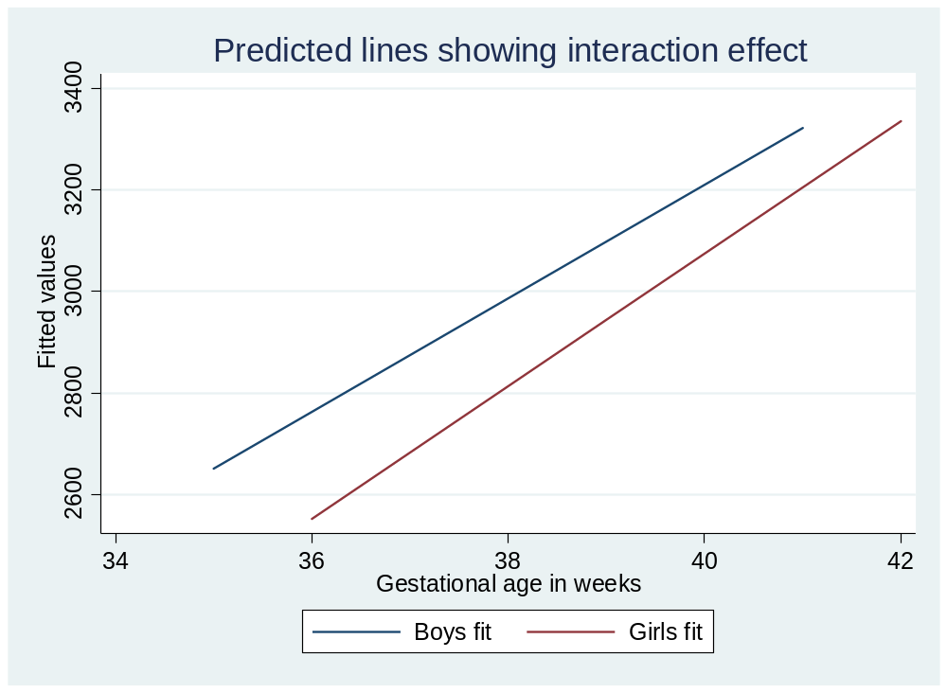
Fitting GLM using stata: example 2
Interaction effect: interpretation
Figure 6 below the interaction effect of age and sex
We can see in Figure 6 that the lines are more or less parallel
Hence there was estimated interaction was not significant p=0.659
Figure 6.
This could have been due to small sample.

Slide 80
Fitting GLM using stata: example 2
Model with Interaction vs model without
One question we may want to answer given that the interaction effect in the last model was not significant is:
Should we have an interaction effect in the model?
We can use the likelihood ratio test to test this.
To do this, we would fit the model with an interaction effect and store the values of this model
And then fit the model without interaction term (nested model) and store the results.

Slide 81
Fitting GLM using stata: example 2
Model with Interaction vs model without
After this, we would then be testing the null hypothesis of:
If we fail to reject the null hypothesis, then there is a possibility that the interaction term is equal to zero, hence we do not keep the model with interaction, accept the model without interaction.
If we reject the null hypothesis, then the interaction regression coefficient is not equal to zero, therefore we accept the model with interaction.

Slide 82
Fitting GLM using stata: example 2
Model with Interaction vs model without
We can do this by using the following command:
xi: glm birthwt c.age##female, family(gaussian) link(identity)
estimates store A
xi: glm birthwt age female, family(gaussian) link(identity)
estimates store B
lrtest A B
The results are shown in the output below.

Slide 83
Fitting GLM using stata: example 2
Model with Interaction vs model without
lrtest A B
Likelihood-ratio test LR chi2(1) = 0.23
(Assumption: B nested in A) Prob > chi2 = 0.6298
We note the p-value=0.630, hence a model with interaction is not a good model, we take the model without interaction.
So, we are further confronted with the question:
Are all assumptions of a linear model satisfied?
This is where we do linear model assumptions checking

Slide 84
Fitting GLM using stata: example 2
Model Checking
What are the things we check for in a linear regression?
To check assumptions of a model, the following are useful:
1. Residuals, for a linear regression, this should be approximately normal with mean zero and constant variance.
Sometimes referred to as homoscedasticity.
So standardized residuals can be checked to see whether they follow a normal distribution using a number of checks.
2. The other thing is that residuals should not be related to explanatory variables

Slide 85
Fitting GLM using stata: example 2
Model Checking
So standardized residuals should be plotted against each of explanatory variables that are included in the model.
If the model adequately describes the effect of the variable, there should be no apparent pattern in the plot.
If it is inadequate, the points may display curvature or some other systematic pattern which would suggest that additional or alternative terms may need to be included in the model.
3. Standardized residuals should be plotted with against fitted values, especially to detect changes in variance.

Slide 86
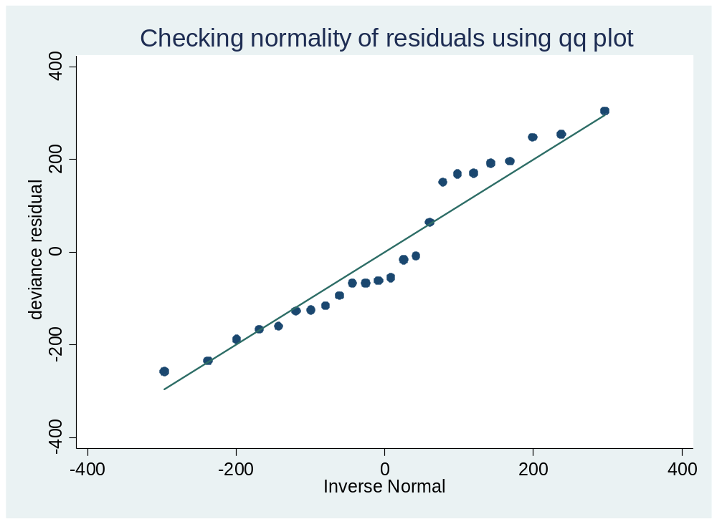
Fitting GLM using stata: example 2
Model Checking
For example, an increase in the spread of the residuals towards the end of the range of fitted values would indicate a departure from the assumption of constant variance (homoscedasticity)
Figure 7 opposite shows that the residuals are all along the reference line of a qq plot, hence normality assumptions of residuals are satisfied.
Figure 7

Slide 87
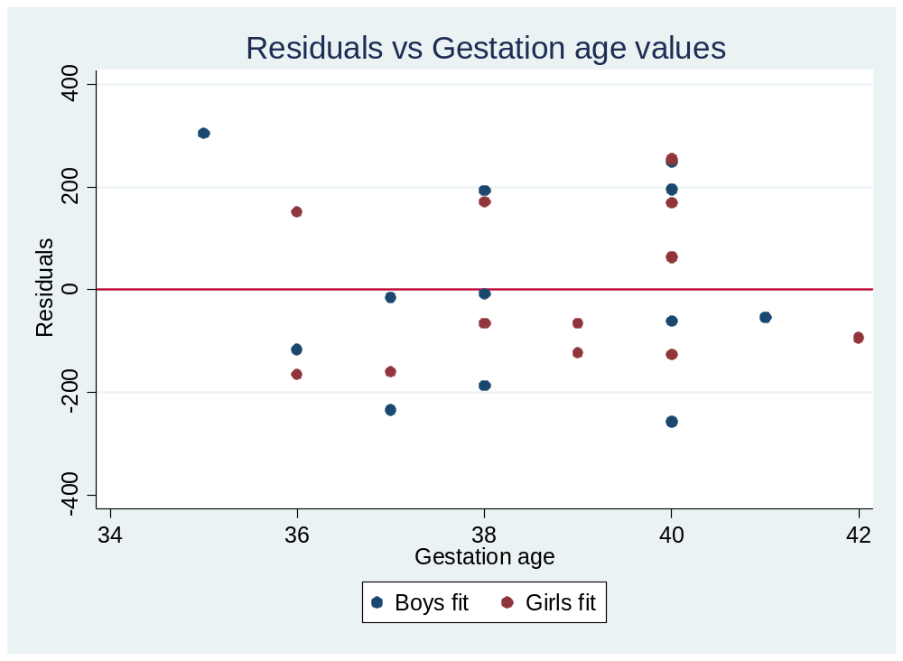
Fitting GLM using stata: example 2
Model Checking
Figure 8 below shows the plot of residuals against explanatory variable (gestation age)
The plot does not show any obvious pattern for either boys or girls.
Hence there is an indication that the model is a better fit for the data
Figure 8.

Slide 88
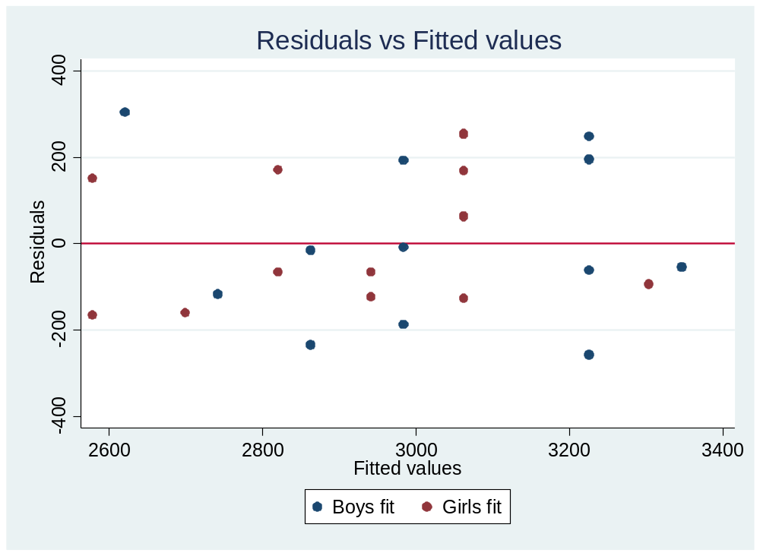
Fitting GLM using stata: example 2
Model Checking
Figure 9 below shows the plot of residuals vs fitted values
Again there is no obvious sign of any pattern of the residuals with the fitted values
This shows that the homoscedasticity assumption is satisfied.
Figure 9

Slide 89
Fitting GLM using stata: example 2
Model Checking
So in the best model of example 2, we have checked that:
1. Residuals follow a normal distribution
2. No pattern of residuals with explanatory variables
3. No pattern of residuals with the fitted values, hence the constant variance is satisfied
Therefore, the assumptions of the linear regression model from the best model in example are satisfied.
Hence we can now trust the conclusions that we are making from the best model.

Slide 90
Exercise 1.
It is well known in medicine that the concentration in blood serum increases with age but it is less clear whether cholesterol level is also associated with body weight. The table below shows serum cholesterol (millimoles per litre) for thirty women, their age (years) and body mass index (weight in kilograms divided height in metres kg/m^2) in a study whose interest was to see whether serum cholesterol is associated with body mass index taking account of age.
1. Given the interest in this study, what is the outcome variable and the corresponding explanatory variable/variables?
2. load the data cholest.dta int stata and Explore graphically by fitting a scatter plot and a fitted line to see whether there is an indication of linear relationship of cholesterol with age or cholesterol with bmi.

Slide 91
Exercise 1. cholesterol data
CHOL | Age | BMI | CHOL | Age | BMI
5.94 4.71 5.86 6.52 6.80 5.23 4.97 8.78 5.13 6.74 5.95 5.83 5.74 4.92 6.69 | 52 46 51 44 70 33 21 63 56 54 44 71 39 58 58 | 20.7 21.3 25.4 22.7 23.9 24.3 22.2 26.2 23.3 29.2 22.7 21.9 22.4 20.2 24.4 | 6.48 8.83 5.10 5.81 4.65 6.82 6.28 5.15 2.92 9.27 5.57 4.92 6.72 5.57 6.25 | 65 76 47 43 30 58 78 49 36 67 42 29 33 42 66 | 26.3 22.7 21.5 20.7 18.9 23.9 24.3 23.8 19.6 24.3 22.0 22.5 24.1 22.7 27.3

Slide 92
Exercise 1. continues
3. Specify the possible regression equation that would address the question of interest in this study using the explanatory variables you stated in question 1.
4. Use a glm command in stata to test the interest in the study as specified in the regression equation in question 3 above. Check whether a regression with an interaction term of the explanatory variables will be adequate.
5. From the model arrived at in question 4, interpret your findings fully (i.e. interpreting the regression coefficient (effect size), mentioning the p-value and 95% CIs in your interpretation.
6. Check whether the model arrived at in question 5 satisfies the assumptions of a linear regression model.

Slide 93
GLM: Introduction SUMMARY
In this course we have looked at the components of a GLM model in particular
1. The probability distribution of the outcome variable, i.e., Normal (Gaussian), Binomial and Poisson distributions. There are other distributions but not covered.
2. Link functions, Identity, Logit, Log, there are others, not covered.
3. Specify the linear predicators with respect to how many explanatory variables we have in the model.
Take note that model from GLM can be fit with other commands in stata.

Slide 94
GLM: Introduction SUMMARY
It does not matter which commands you use.
Most important thing is to interpret your results correctly.
Sometimes questions of interest may require us to fit interaction effect.
We need to now how to fit an interaction effect whether both continuous or one categorical and one continuous or both categorical.
We should be able to check whether we should keep a variable in the model or not using the likelihood ratio test.

Slide 95
Bibliography for further reading
Basic Medical Statistics Books :
DG Altman (1994) Practical Statistics for Medical Research. 2nd Ed. Chapman and Hall, London.
M Bland (1996) An Introduction to Medical Statistics. 2nd Ed. Oxford University Press, Oxford.
MJ Campbell and D Machin (1990) Medical Statistics : A Commonsense Approach. John Wiley and Sons, Chichester.
RD Cook and S Weisberg (1994) Residuals and Influence in Regression. London, CRC/Chapman & Hall.
AJ Dobson (2002) An Introduction to Generalized Linear Models. 2nd Ed. Chapman and Hall, London.
A Hart (2001) Making Sense of Statistics in Health Care. Radcliffe Medical Press, Abingdon.
DW .Jr Hosemer S. Lemeshow (2000) Applied Logistic Regression. 2nd ed. New York: Wiley.
BR Kirkwood & Sterne JAC (2003) Essential medical statistics, 2nd ed. Oxford: Blackwell Science.
JM Landwehr D Pregibon and AC Shoemaker (1984) Graphical methods for assessing logistic regression models. Journal of the American Statistical Association. 79: 61-71.
TA Mroz (1987) The sensivity of an empirical model of married women’s hours of work to economic and statistical assumptions. Econometrica 55: 765-799.
S Piantadosi (1997) Clinical Trials: A Methodologic Perspective. New York, Wiley.
GUH Seeber (1989) On the regression analysis of tumour recurrence rates. Statistics in Medicine 8: 1363-1369.
JW Tukey (1977) Exploratory Data Analysis, Addison-Wesley, New York.

